Slide 1
AI - POWERED SHRIMP HEALTH AND AQUACULTURE INTELLIGENCE

Slide 2
Introduction
Project Overview
.Hybrid Deep Learning Approach: This project presents a vision-based system for shrimp health and growth monitoring that utilizes Convolutional Neural Networks (CNNs) and Transfer Learning (MobileNet/EfficientNet).
.Multimodal Analysis: The system captures morphological signs for real-time disease classification (e.g., White Spot, Black Gill) and implements non-invasive algorithms for size and weight estimation.
.Data-Driven Insights: Trained on a dataset of 15,149 high-resolution images from local farms and Kaggle, the model calculates pond biomass to provide precise, farm-specific recommendations.
.Intelligent Resource Management: The system integrates a Smart Feed Calculator and weather forecasting to optimize Feed Conversion Ratios (FCR), reducing waste and mortality.
.Scalable Deployment: The entire pipeline is deployed as a user-friendly mobile application (Flutter/React Native) with an AI chatbot, bridging the gap between technical AI capabilities and practical farming needs.

Slide 3
Problem Statement:
Shrimp farming is a high-value sector, yet it remains vulnerable to sudden losses due to undetected diseases and inefficient manual management. Existing practices face three critical challenges:Manual Inefficiency and Error: Current methods for disease diagnosis and size estimation are largely manual, slow, and prone to human error, often requiring expensive expert intervention.High Technical Barriers: Existing high-tech solutions rely on expensive IoT sensors or specialized hardware that are financially out of reach for small-to-medium-scale farmers.Delayed Action and Resource Waste: Laboratory-based testing takes days, leading to high mortality rates during outbreaks. Furthermore, inaccurate biomass estimation leads to overfeeding, which increases costs and degrades water quality.There is a critical need for an all-in-one, affordable AI platform that provides real-time, explainable health and growth analysis using standard mobile devices to improve farm productivity and sustainability.

Slide 4
PROPOSED SOLUTION
Core Model: Convolutional Neural Networks (CNNs) and Transfer
• Learning (e.g., MobileNet or EfficientNet) for lightweight,
high_x0002_accuracy image classification.
• Reason for Choice: These models are optimized for mobile
deployment, ensuring farmers can get results in the field without
high-end computers.
• Functionality:
• Vision-Based Diagnosis: Instant disease detection from mobilephotos.
• Automated Biomass Tracking: Estimating weight and population
needs via 2D image analysis.
• Smart Feed Calculator: Integrating growth stages and health status
to refine Feed Conversion Ratios (FCR)

Slide 5
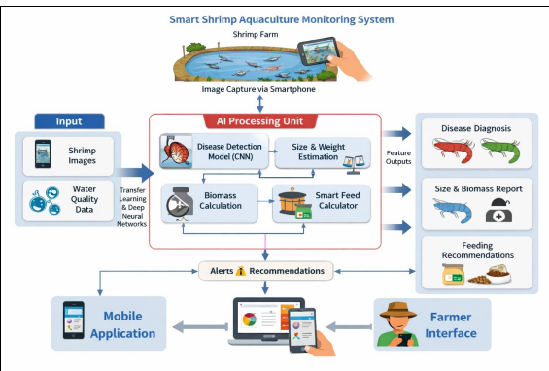
METHODODLGY:

